Slide 1
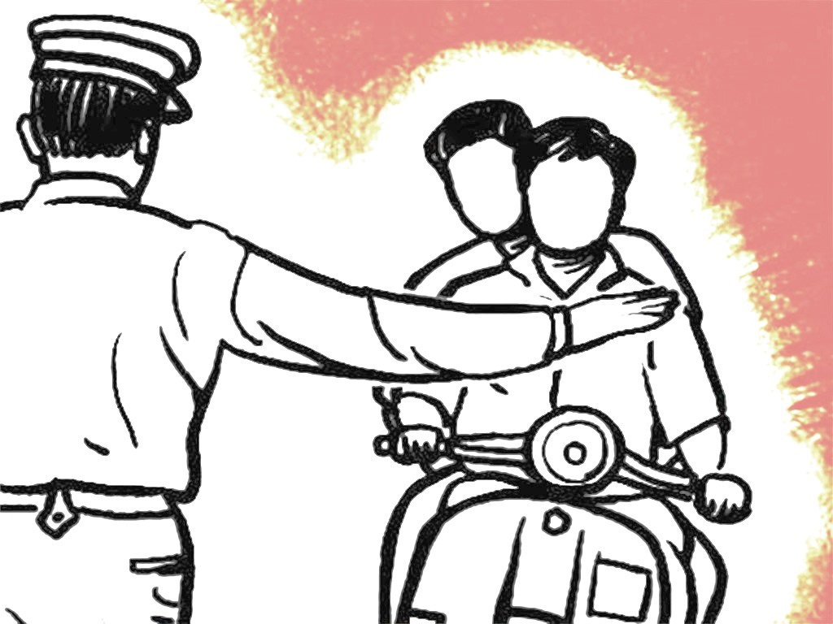
Smart Traffic Management Solution
Manmohan Kumar
Simarjeet Singh Chera
Manhar Thakur
Vasudev Gupta

Slide 2
Agenda
Problem Statement
Brief Description
Uniqueness of Solution.
Technologies Used

Slide 3
Problem Statement
Due to increased vehicular traffic violations in cities, traffic offences have also grown.
We propose to Digitize issuance of Traffic Challan using digital and easy to use modern technologies.
The solution should support addition of unique identification No. (Aadhar card).
Along with Driving license and vehicle registration certificate.

Slide 4
Brief Description
Issuance of Traffic Challan is still manual process. And takes a considerable amount of paper work to issue challan to a offender.
During a challan drive, vehicles form long queues, due to Manual Process of filling out Challan forms.
First the police officer spots a possible violator. Asks for various documents like Driving license, Registration certificate. Fills challan form and issues the challan.
Here we are trying to digitize the challan issuance process using Aadhar card.
Gamification implemented on basis of challan count of police officers.

Slide 5
Uniqueness of our solution
Solution get its uniqueness from the fact that here, the application doesn’t require any extra hardware to be carried except usually carried pocket smart phone.
The Challaning officer only has to fill certain fields in form of user details and submit it to issue challan.
Some people are also proclaimed offenders. The app keeps the Challan history of a person and displays it after a challan is issued.
Tracks funds collected by traffic police. Also puts trace information on previous offences committed by driver/vehicle.

Slide 6
Technologies used
Java 1.8, Spring boot 1.3.3, Hibernate | Domain - Smart City
Swagger, Angular 2, Ionic 2, Node6.5
Cordova1.5, Android sdk 25
Postgresql-9.2.19-1

Slide 7
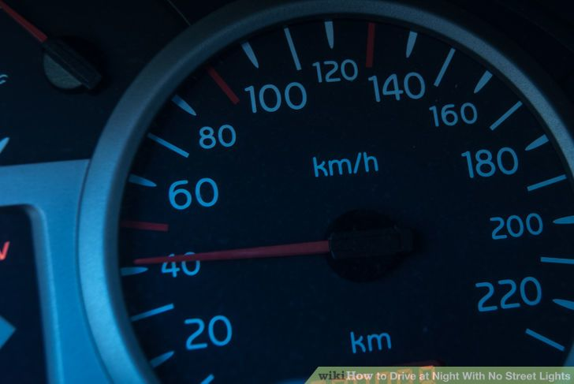
Thank You

